Slide 1
Secure Your ASP.NET WebApi and MVC Applications
Bob Walker
Lead Application Developer
Farm Credit Services of America

Slide 2

About
Full-Stack developer since 2004
Lead Application Developer at Farm Credit Services of America
Previously worked for CRi, TelventDTN (later Schneider Electric), West Corporation, and Sandhills Publishing
Married in 2015
Passions: Software Development, Cycling, Photography
Site: CodeAperture.io
Twitter: @CodeApertureIO

Slide 3
Goal For Presentation
General Understanding of Security Threats
Tips and Tricks you can apply Monday morning
Get the bits: https://github.com/CodeAperture/HDC2016

Slide 4
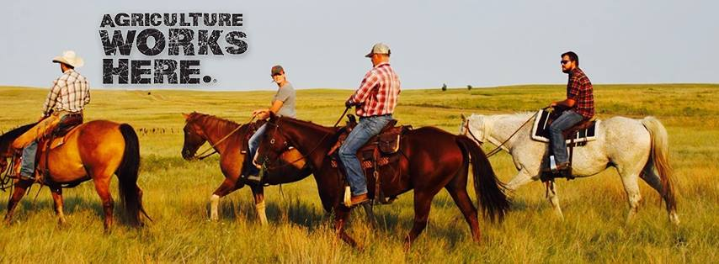
Farm Credit Services of America
Part of Farm Credit System which started in 1916
Lending institution providing credit to 1/3 of rural America
Types of loans
Budget
Line of Credit
Real Estate
Country Home Loan
My Team is responsible for one of the loan origination systems

Slide 5
Farm Credit Services of America is a Target for

Slide 6
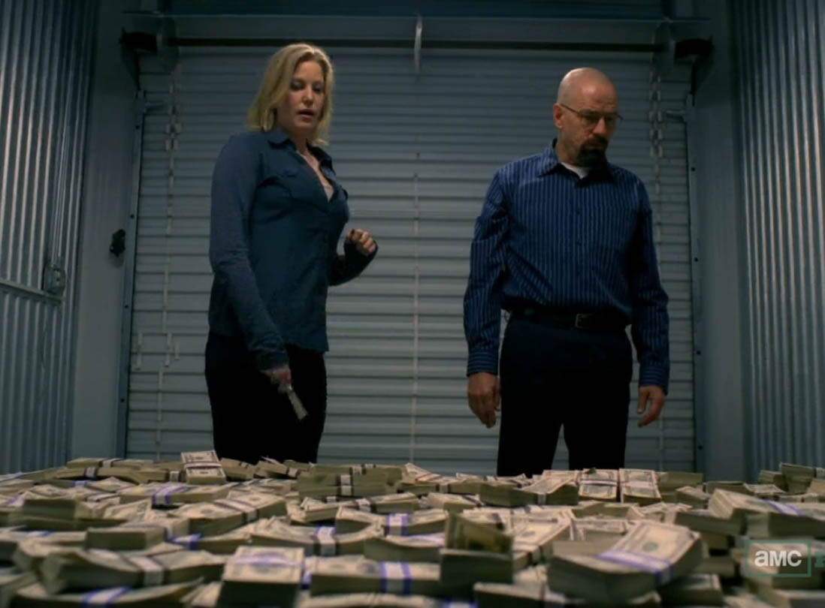

Slide 7
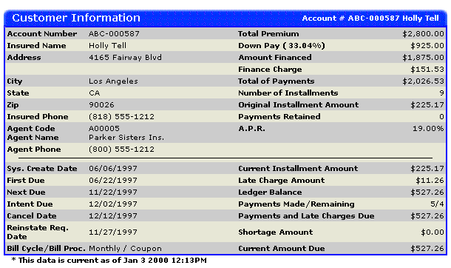

Slide 8
Security is Paramount

Slide 9
100% Security is Impossible

Slide 10
Have realistic security expectations

Slide 11
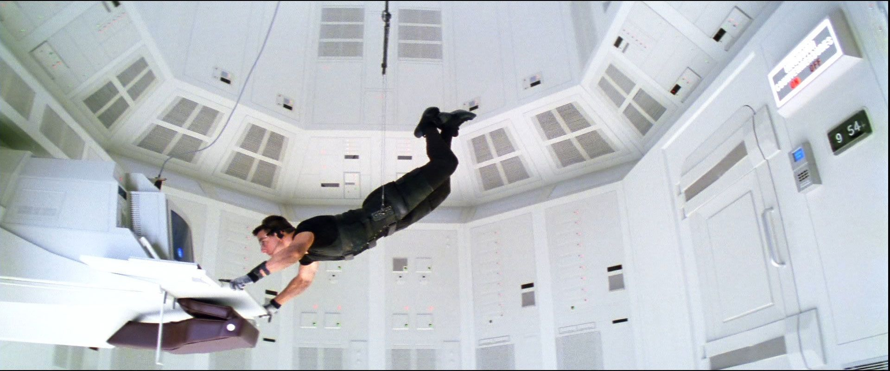

Slide 12
We Exist to Serve Our Users

Slide 13


Slide 14
There is a struggle between usability and security

Slide 15
A Realistic Approach to Security

Slide 16
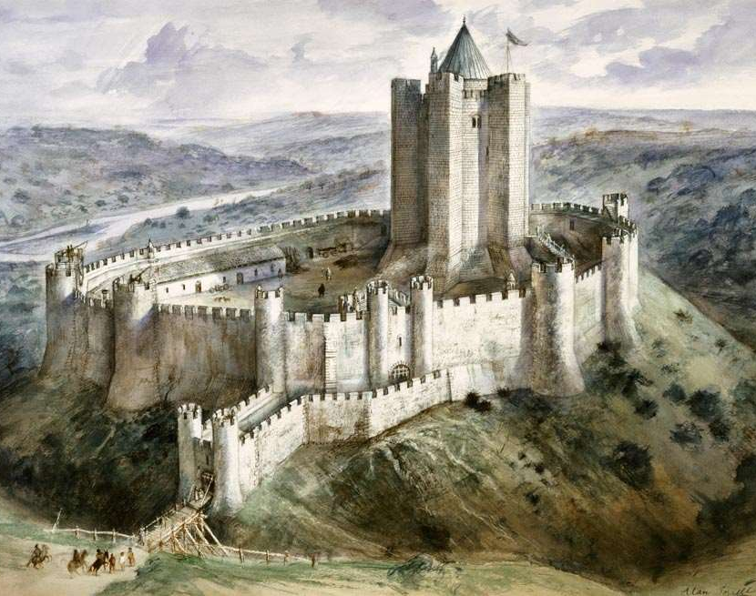
Layers Of Security
Authentication
Authorization
Data Validation
Content Filters
Action Filters
Encryption
Hashing
Code Reviews
White-Hat Hacking
Code Analysis

Slide 17
Developer Quotes
“We use https, we’re good”
“Why do we need to do all this? It seems redundant”
“This is an internal application, I don’t need to worry about security”

Slide 18
They’re right…

Slide 19
The goal is to make it difficult for attackers

Slide 20


Slide 21
Primary Point of this presentation

Slide 22
Start thinking globally

Slide 23
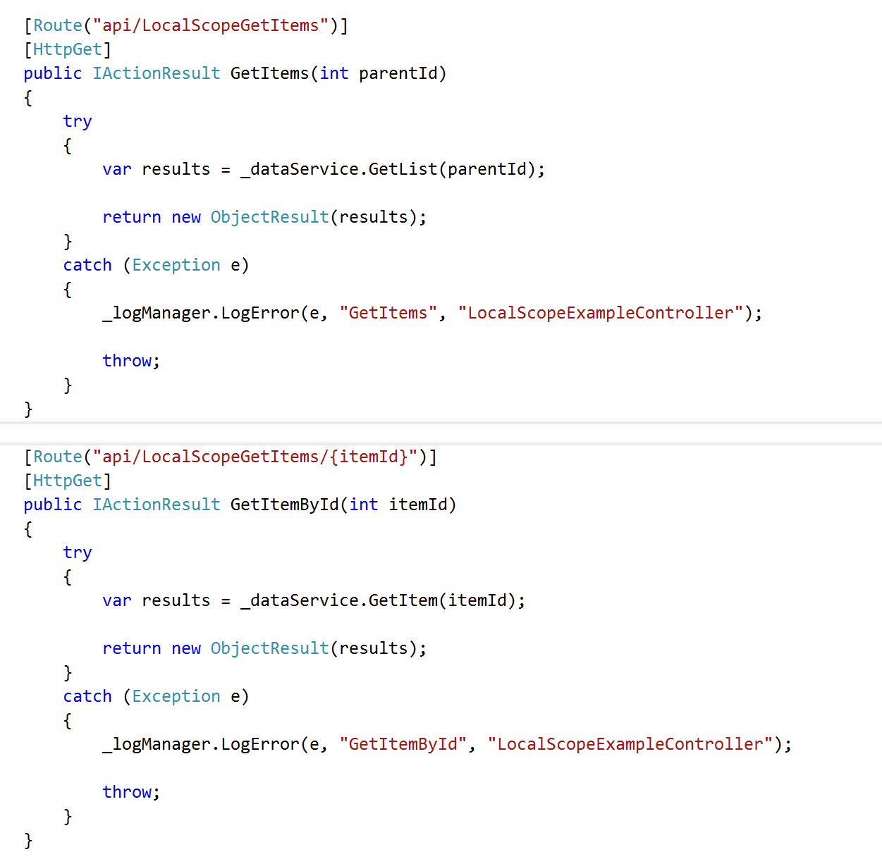

Slide 24
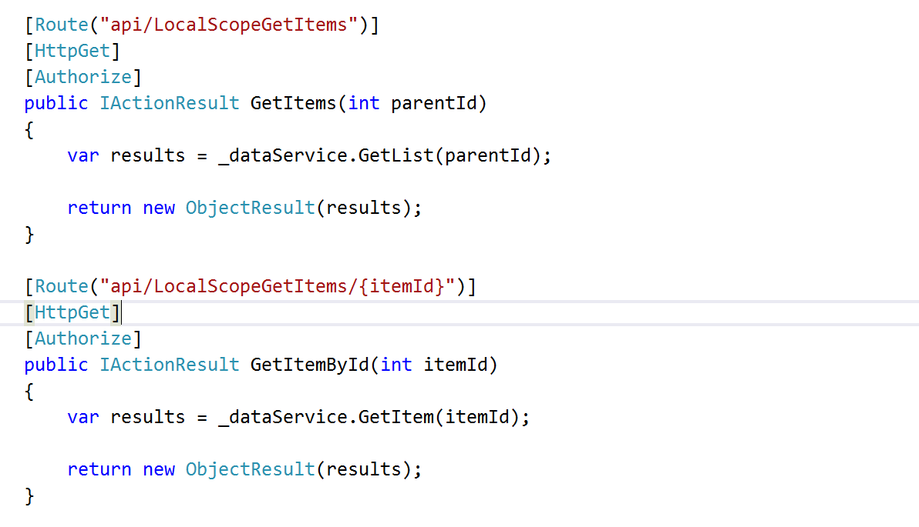

Slide 25
Object Level Security Problems
Developers will forget (we’re human!)
Inconsistency
More code to maintain
Duplicated code

Slide 26
It’s Mathematics
25 WebApi Controllers
x 4 Method Per Controller (CRUD)
= 100 Attributes
50 WebApi Controllers
x 4 Method Per Controller (CRUD)
= 200 Attributes

Slide 27
Application Level Security

Slide 28
Application Level Security Settings
Web.config / App.config
Global.asax
Exception Filters
Action Filters
DbContext (if using Entity Framework)

Slide 29
Cross-Site Scripting Mitigation

Slide 30
Cross-Site Scripting (XSS)
JavaScript is injected into a system
Persistent
Non-Persistent (reflective)
Downloads malicious payload
Sends cookie information (session hijacking)
Keystroke logger
Viruses

Slide 31
Content Security Policy

Slide 32
Content Security Policy
Response Headers
Whitelist of acceptable sources / Blacklist of unacceptable sources
Types
JavaScript
Images
CSS
Websocket
Disables inline CSS, eval function, setTimeout, setInterval, DOM event handlers
Configured in web.config

Slide 33
Content Security Policy Rules Of Thumb
Blacklist everything
Whitelist only accepted sources
Test, test, test
Don’t blindly add

Slide 34
Content Security Policy Demo

Slide 35
AntiXSS Library

Slide 36
AntiXSS Encoder
Library Provided by Microsoft
All Characters not found in the safe list are encoded

Slide 37
AntiXSS Encoder Demo

Slide 38
XSS Leads to Session Hijacking

Slide 39
Session Hijacking
An Attacker using XSS is able to hijack session cookies
Attackers go after credentials for
E-Commerce Sites (Amazon, NewEgg, etc.)
Banking
Email

Slide 40
Cookie Policies

Slide 41
Cookie Policy
HttpOnlyCookies - Any cookie sent from the server cannot be accessed via JavaScript
RequireSSL – Cookies are only sent when accessing SSL side
Configured in web.config

Slide 42
Cookie Policy Demo

Slide 43
SQL Injection

Slide 44
SQL Injection
Attacker Maps an application’s database using a tool like SQLMap
Selects Sensitive Information (SS#, DOB, etc.)
Injects XSS

Slide 45
Exception Information
Same information to debug problems is used by attackers
SQL Exception
Query Ran
Column Name
Table Names
Exception on REST calls
End Point Hit
Parameters
Headers

Slide 46
Exception Filter

Slide 47
Exception Filter
Handles all errors thrown
Logs Error Details for development team
Only Exposes Minimum Information to user
Configured in the Global.asax file

Slide 48
Exception Filter Demo

Slide 49
Action Filters

Slide 50
Action Filters
Custom Business Logic to enforce security
Can run before or after request is complete
All Action Filters must run before controller method is run
Able to access dependency injector
Configured through Global.asax

Slide 51
Help Prevent SQL Injection
Encode Data Coming In
Transform ‘ into ‘’
Ensure Type Safety
Encode HTML
Encode Data Going Out
Encode HTML / JavaScript

Slide 52
Action Filter Demo

Slide 53
Loan Application Action Filter
Loan Cannot Be Edited When
It is in “completed” state
Opened by another user
User is viewing in read-only mode
Throw Exception when user attempts to edit
Be sure to log exception (for auditing!)

Slide 54
Protect Your Database

Slide 55
Configuration
Don’t store username/password in web.config
Don’t grant rights to built in roles (db_datareader, db_datawriter) for application service account
Grant permissions at schema level
Grant select to dbo
Grant CRUD to custom schema
Use different service accounts per application

Slide 56
SDLC Improvements

Slide 57
Start the security conversation
The earlier in your SLDC the better
As you add features
Training

Slide 58
Automated Testing
Security Exploits are often times nothing more than a missing test case
Unit Tests
Service Tests
UI Tests

Slide 59
White-Hat Hacking
Hack your site
Be as evil as you can be
Get permission first! (It’s illegal without permission)

Slide 60
Code Reviews
Evaluate for possible security flaws
SQL Injection (dynamic SQL)
XSS (reflective and persistent)
Security disabled to support business needs
Object Level Security (try/catch blocks, attributes, etc.)

Slide 61
Create Intrusion Detection Plan

Slide 62
Example Parts of Plan
Intrusion detection
Automated
Manual
Logging
Response
Data Cleanup
Customer Notification (talk to your Legal Team!)
Post Mortem

Slide 63
Don’t Start Plan After Your Compromised

Slide 64
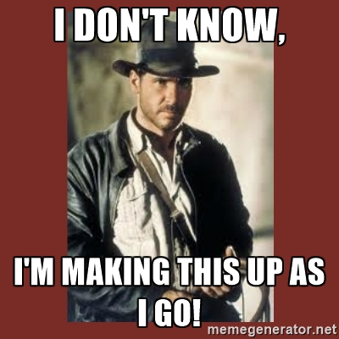

Slide 65
Not all doom and gloom

Slide 66
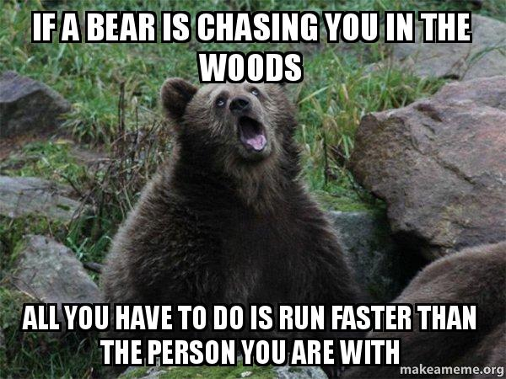

Slide 67
Don’t think you have to do all this Monday

Slide 68
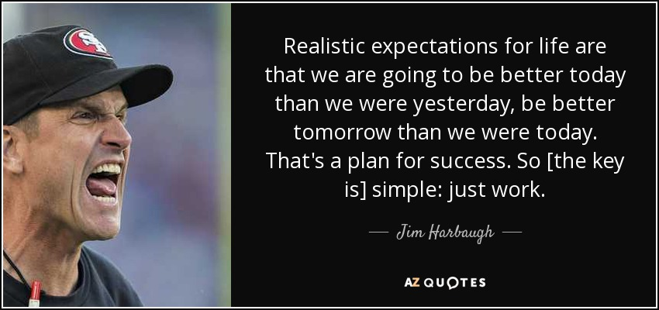

Slide 69
Questions?

Slide 70
Thank you!
@CodeApertureIO
bob.walker@codeaperture.io
https://github.com/CodeAperture/HDC2016

